Slide 1

Predictive Model For CIMT Inflammation
By Shivam Bamania

Slide 2
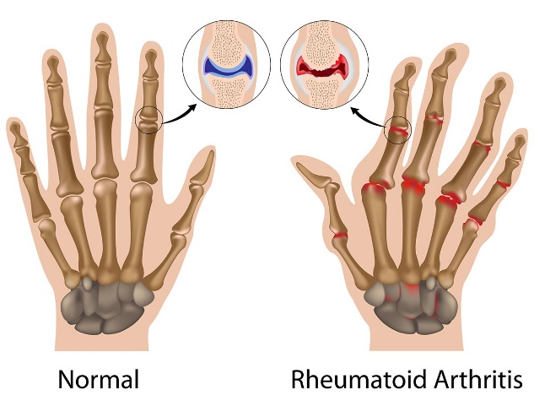
Rheumatoid Arthritis
Rheumatoid arthritis (RA) is an autoimmune disorder that primarily affects the joints, causing inflammation, pain, stiffness, and eventually joint damage and deformity. Chronic inflammation in RA can lead to the thickening of the synovial lining of the joints, resulting in cartilage and bone destruction.
Carotid intima-media thickness (CIMT) is a measure used to assess the health of the carotid arteries, which are major blood vessels in the neck that supply blood to the brain. CIMT is a marker of atherosclerosis, the buildup of plaque within arterial walls, which can lead to narrowing and hardening of the arteries, increasing the risk of stroke and heart disease.

Slide 3
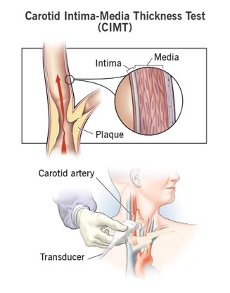
Objective
Why CIMT Inflammation predictive model?
The model suggests whether rheumatoid arthritis patients should undergo a CIMT test based on their TJC, SJC, ESR, and CRP results, offering a cost-effective alternative for test necessity assessment. Backed by data, it enhances accuracy over doctors' instincts, addressing cardiovascular risk efficiently.

Slide 4
Data Overview
Patient Selection: Data collected from 140 rheumatoid arthritis patients at ESI-PGIMSR and Hospital Basaidarapur, New Delhi, fulfilling modified ACR criteria.
Metrics Recorded: Demographics (age, sex), disease duration, clinical indicators (ESR, TJC, SJC), and biomarkers (CRP, Anti CCP, RF) for disease severity and immune response.
Key Variable - CIMT IN (MM): Evaluates Carotid Intima-Media Thickness, crucial for assessing cardiovascular risk in rheumatoid arthritis; patients selected from the hospital's rheumatology clinic.

Slide 5
Features in the data
Age
Sex
Duration of Disease Year
ESR (Erythrocyte Sedimentation Rate)
TJC (Tender Joint Count)
SJC (Swollen Joint Count)
CRP (C-Reactive Protein)
Anti CCP (Anti-Cyclic Citrullinated Peptide Antibodies)
RF (Rheumatoid Factor)
CIMT IN (MM) (Carotid Intima-Media Thickness in millimeters)

Slide 6
Importance of features
1. Age
Role: Age can indicate the patient's overall health status and potential risk factors associated with age-related diseases.
Importance: Older age is often associated with increased risk of inflammation and cardiovascular diseases, which can affect CIMT.
2. Sex
Role: Sex can influence disease prevalence and presentation, with certain conditions being more common or severe in one gender over the other.
Importance: Differences in CIMT inflammation between sexes may highlight gender-specific risk factors or biological differences contributing to the disease.

Slide 7
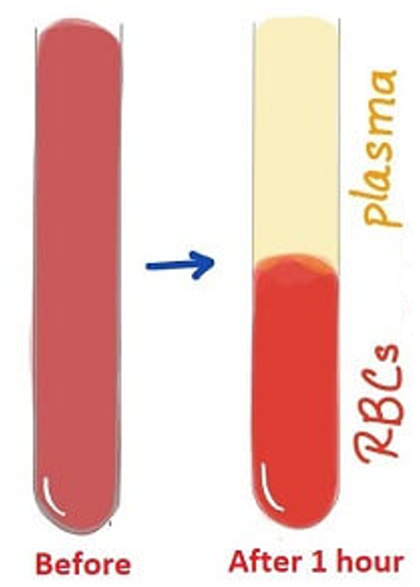
Importance of features
3. Duration of Disease in Year
Role: Duration of disease provides insight into the chronicity and progression of the underlying condition.
Importance: Longer duration may suggest more advanced disease states, potentially correlating with increased CIMT inflammation and severity.
4. ESR (Erythrocyte Sedimentation Rate)
Role: ESR is a non-specific marker of inflammation and is commonly elevated in various inflammatory conditions.
Importance: Elevated ESR levels may reflect systemic inflammation, which can contribute to vascular inflammation and CIMT thickening.

Slide 8
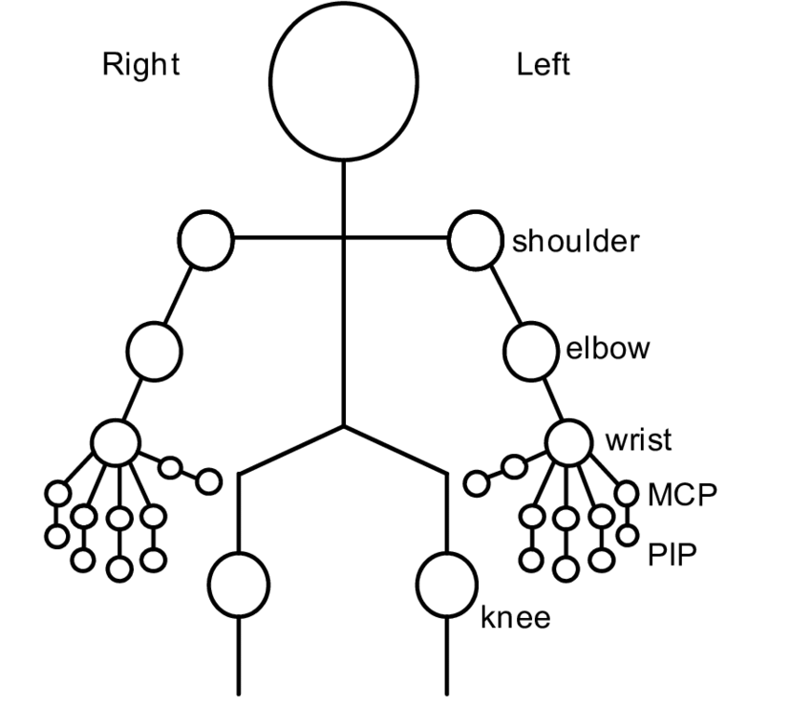
Importance of features
5. TJC (Tender Joint Count)
Role: TJC is a measure of joint tenderness and is used in disease assessment, particularly for rheumatic diseases like rheumatoid arthritis.
Importance: Higher TJC scores may indicate more active disease and systemic inflammation, which could contribute to CIMT inflammation(28-joint Disease Activity Score (DAS28)).
6. SJC (Swollen Joint Count)
Role: SJC measures joint swelling and is another important parameter in rheumatic disease evaluation.
Importance: Similar to TJC, elevated SJC scores suggest ongoing inflammation and disease activity, potentially influencing CIMT inflammation.

Slide 9
Importance of features
7. CRP (C-Reactive Protein)
Role: CRP is another marker of inflammation and is more sensitive than ESR in detecting acute inflammation.
Importance: Elevated CRP levels are associated with increased cardiovascular risk and may indicate vascular inflammation contributing to CIMT.
8. Anti CCP (Anti-Cyclic Citrullinated Peptide Antibodies)
Role: Anti CCP antibodies are specific to rheumatoid arthritis and are used for diagnosis and disease monitoring.
Importance: Presence of Anti CCP antibodies indicates autoimmune inflammation, which can contribute to CIMT thickening and cardiovascular risk in rheumatoid arthritis patients.

Slide 10
Importance of features
9. RF (Rheumatoid Factor)
Role: RF is another antibody marker used in rheumatoid arthritis diagnosis and prognosis.
Importance: Positive RF status is associated with more severe rheumatoid arthritis and increased cardiovascular risk, potentially influencing CIMT inflammation.
10. CIMT IN (MM) (Carotid Intima-Media Thickness in millimeters)
Role: CIMT is a marker of subclinical atherosclerosis and vascular health, often assessed through ultrasound imaging.
Importance: CIMT serves as the primary outcome variable, reflecting vascular inflammation and atherosclerotic burden, which can be influenced by the above features.

Slide 11

EDA of the Data

Slide 12
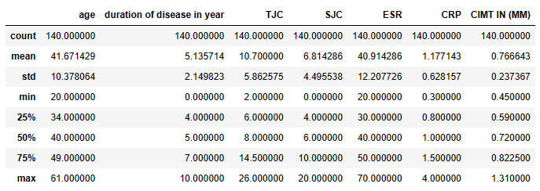
Descriptive Statistics

Slide 13
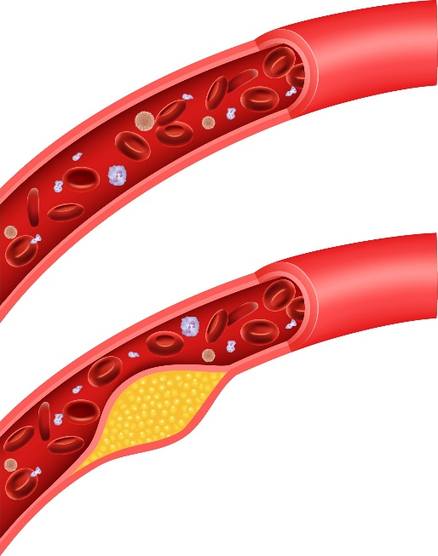
CIMT Inflammation (Target Variable)
Clinical Significance: Carotid Intima-Media Thickness (CIMT) serves as a critical marker for cardiovascular risk assessment. Elevated CIMT levels, particularly exceeding a threshold like 1 mm. By defining this threshold, healthcare professionals can effectively identify individuals with increased cardiovascular risk, enabling targeted interventions.
Decision Support: Categorizing CIMT inflammation into binary categories (above or below the critical threshold) facilitates informed decision-making in patient management. Patients exceeding the critical threshold may necessitate closer monitoring, lifestyle adjustments, or additional medical interventions to mitigate cardiovascular risk effectively.
Model Enhancement: Utilizing a binary classification approach simplifies model interpretation and enhances performance in predicting cardiovascular risk.

Slide 14
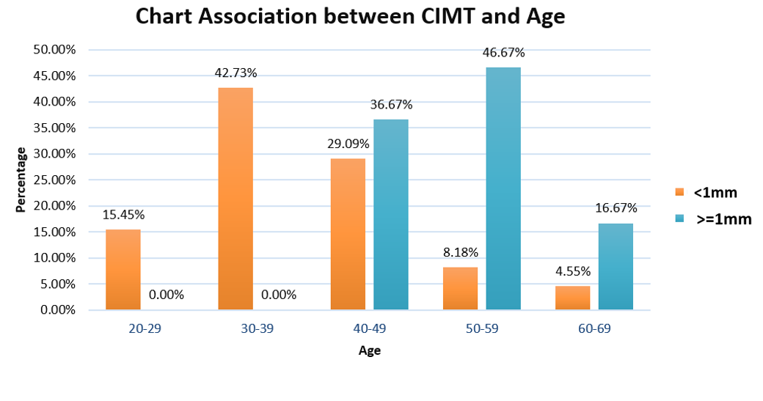
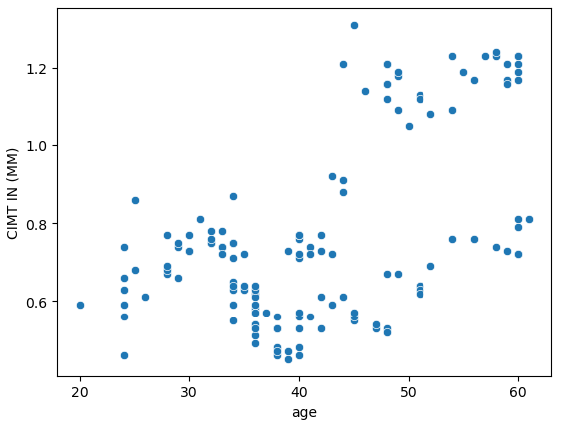
Age
The age composition within our study cohort ranged from a minimum of 20 years to a maximum of 60 years, mirroring a diverse demographic.

Slide 15
Gender
Table 1
Table 2
Gender | Number of Patients | Mean age (years) | Standard deviation
Female | 101 | 42.2277228 | 10.79155335
Male | 39 | 40.2307692 | 9.195140417
Grand Total | 140 | 41.6714286 | 10.37806407
Gender | CIMT Inflammation
 | <1mm | >=1mm | Grand Total
F | 70.00% | 80.00% | 72.14%
M | 30.00% | 20.00% | 27.86%
Grand Total | 100.00% | 100.00% | 100.00%
This study included 140 subjects out of which 101 were female and 39 were male with female to male ratio of 2.5:1. The mean age of the study group were 41.67 years with standard deviation of 10.378. This study concluded that rheumatoid arthritis is more common among females than males. (Table 1)
30.0% of the participants in the group [CIMT: <1 mm] had [Gender: Male]. 70.0% of the participants in the group [CIMT: <1 mm] had [Gender: Female]. 20.0% of the participants in the group [CIMT: ≥1 mm] had [Gender: Male]. 80.0% of the participants in the group [CIMT: ≥1 mm] had [Gender: Female]. (Table 2)

Slide 16
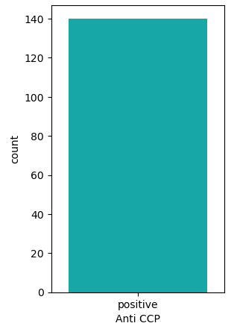
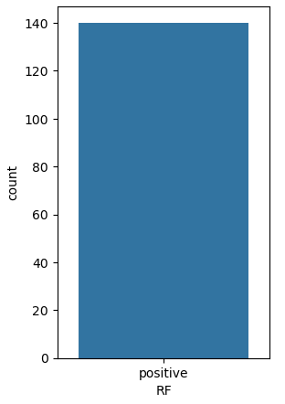
Anti CCP & RF
Among the recorded clinical indicators, TJC and SJC are traditionally ordered as primary diagnostic metrics for rheumatoid arthritis.
ESR (Erythrocyte Sedimentation Rate) and CRP (C-Reactive Protein) follow in the diagnostic hierarchy, providing additional insights into disease severity and inflammation levels.
Notably, CIMT (Carotid Intima-Media Thickness), Anti CCP (Anti-Cyclic Citrullinated Peptide), and RF (Rheumatoid Factor) are considered more expensive and specialized tests, often reserved for confirming diagnosis or monitoring disease progression.
Since all 140 patients in our dataset have positive results for Anti CCP and RF, indicating the presence of rheumatoid arthritis, we can consider dropping these features to simplify our analysis and reduce computational overhead.

Slide 17

SJC & TJC
The mean of SJC in the CIMT: <1 mm group is 6.22 . The mean of SJC in the CIMT: ≥1 mm group is 9.00.
The mean of TJC in the CIMT: <1 mm group is 9.53 . The mean of TJC in the CIMT: ≥1 mm group is 15.00 .

Slide 18
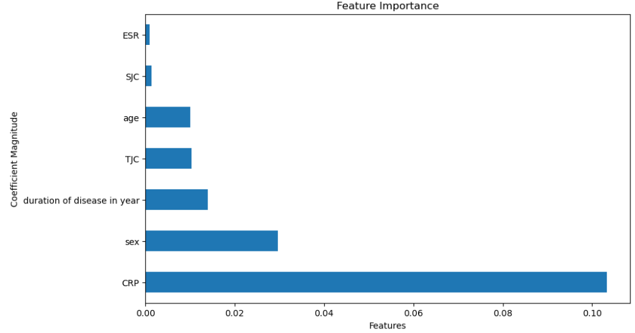

Feature Importance

Slide 19
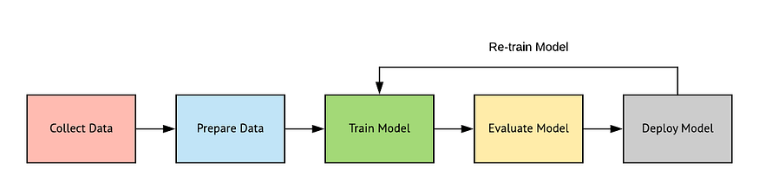
Modeling Approach & Training
Comparing different Models.
Understanding what is Bagging Classifier.
Explanation of why Bagging Classifier with AdaBoost estimator was selected.
Description of the model training process.

Slide 20
Comparing Model
Classifier Model | Training Score Accuracy | Testing Score Accuracy
Decision Tree Classifier | 100% | 78.57%
Random Forest Classifier | 100% | 89.29%
K-neighbors Classifier | 91.07% | 67.86%
AdaBoost Classifier | 100% | 92.86%
Gradient Boosting Classifier | 100% | 89.29%
Logistic Regression | 89.29% | 82.14%
Bagging Classifier | 100% | 92.86%
Bagging and AdaBoost outperform other classifiers.

Slide 21
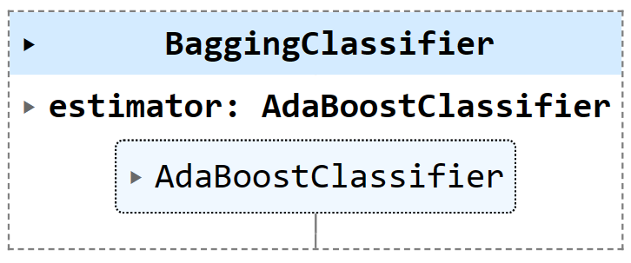
Bagging Classifier(estimator Adaboost )
Bagging Classifier with AdaBoost achieved high accuracy scores on both the training and testing sets (95.54% and 92.86% respectively). This indicates that the model performs well and generalizes effectively to unseen data.

Slide 22
Bagging Classifier(estimator Adaboost )
Imagine you're trying to make a decision, like choosing a movie to watch. You ask your friends for recommendations, but instead of just asking them once, you ask them multiple times. Each time you ask, you give more weight to the opinions of friends who gave better recommendations in the past.
In this scenario:
Your friends represent individual models (like decision trees) in the Bagging Classifier.
Each recommendation they give is like a prediction made by a model.
Giving more weight to friends who gave better recommendations in the past is similar to how AdaBoost works—it focuses more on the models that performed well previously.
So, Bagging Classifier with AdaBoost combines the idea of asking multiple friends (Bagging) with the strategy of giving more weight to the opinions of those who have been more accurate in the past (AdaBoost). This combination helps make better decisions or predictions by leveraging the strengths of multiple models and focusing on the ones that have performed well.

Slide 23
Bagging Classifier(estimator Adaboost )
Handling of Imbalanced Data:
AdaBoost, a component of Bagging Classifier with AdaBoost, is effective in handling imbalanced data by adjusting the weights of misclassified instances during training.
This capability helps in achieving high accuracy on both classes, which is crucial in scenarios where classes are imbalanced.
Robustness to Overfitting:
Bagging Classifier with AdaBoost showed consistent performance on both training and testing sets, indicating robustness to overfitting.
This contrasts with Decision Tree Classifier, which exhibited 100% accuracy on the training set but lower accuracy on the testing set, suggesting overfitting to the training data.
Versatility and Stability:
Bagging Classifier with AdaBoost is versatile and can be applied to various classification tasks, as demonstrated by its high accuracy across different datasets.
It combines the stability of Bagging with the adaptability of AdaBoost, resulting in improved performance compared to individual models like Decision Trees or Random Forests.

Slide 24
Conclusion
In conclusion, our study emphasizes the importance of integrating rheumatologic symptoms with traditional risk factors for assessing cardiovascular risk in rheumatoid arthritis patients. By predicting CIMT inflammation based on TJC, SJC, ESR, and CRP, our model offers a cost-effective alternative for test necessity assessment, enhancing accuracy and addressing cardiovascular risk more efficiently than relying solely on doctors' instincts. This approach aids in the early detection of subclinical atherosclerosis, aiming to improve outcomes and reduce morbidity and mortality in RA patients.

